Slide 1
Fun with APIs -
Brighton Java
23rd September 2019

Slide 2
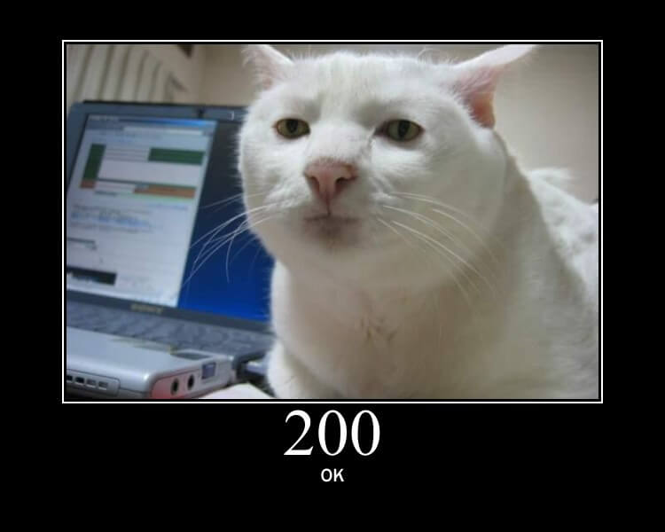
Welcome!
https://http.cat/200
Notes:
I think everyone will able to produce something interesting in a couple of hours, despite Java’s reputation for being being heavyweight (although we might have to skip error handling and testing).

Slide 3
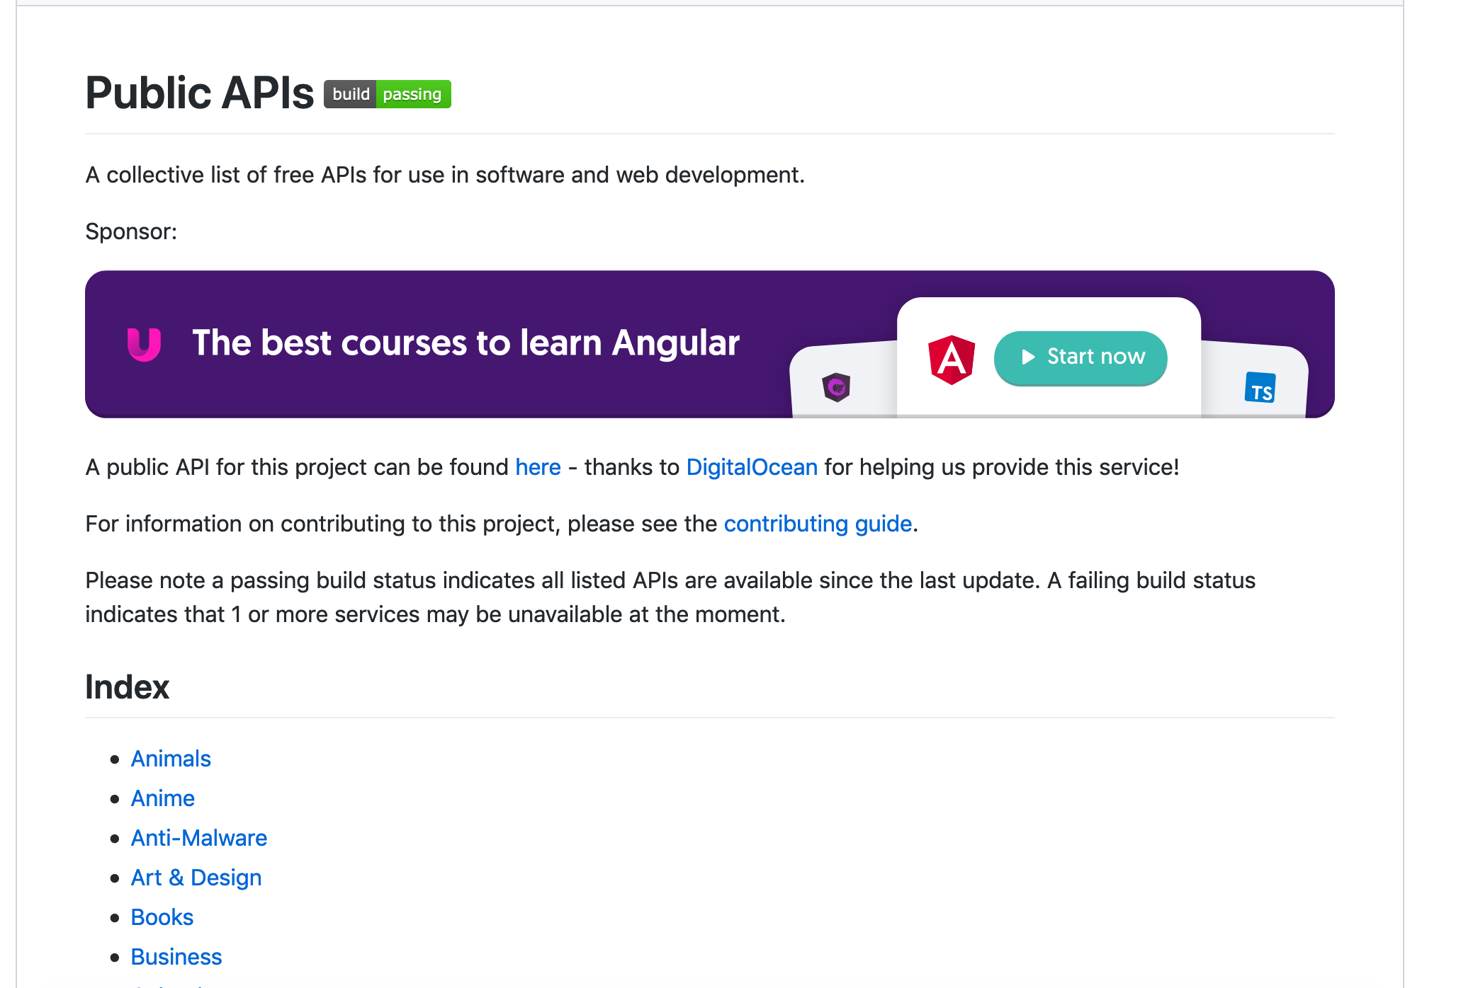
Combining APIs is easy

Slide 4
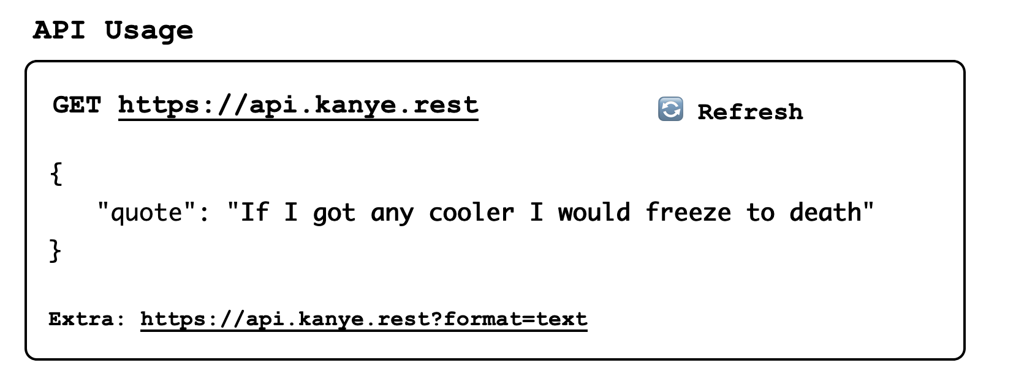
kanye.rest

Slide 5
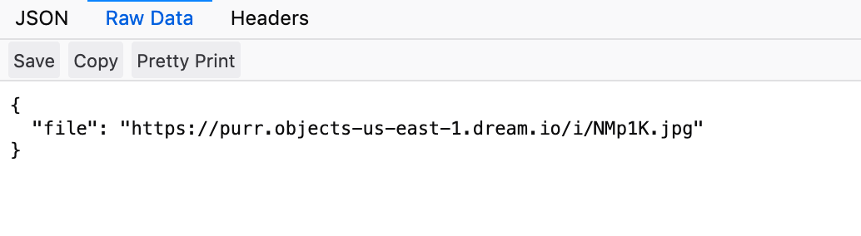
kanye.rest + cats

Slide 6
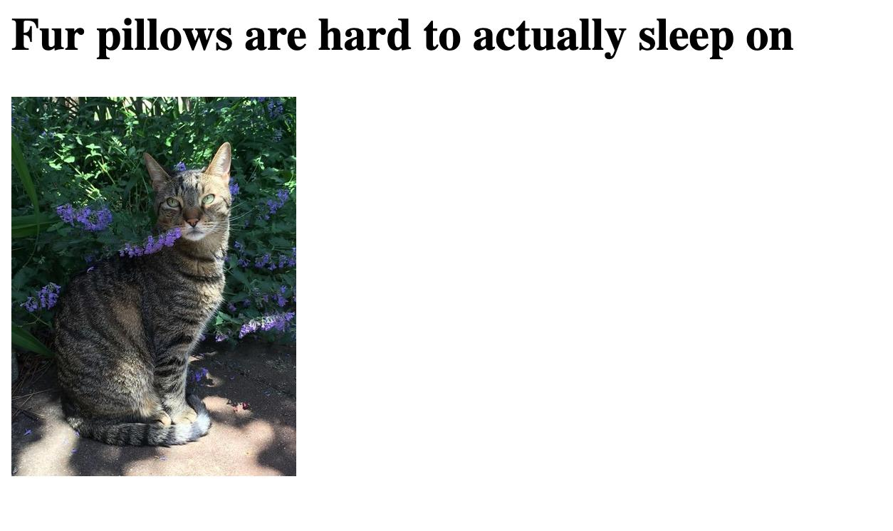
kanye.rest + cats =

Slide 7
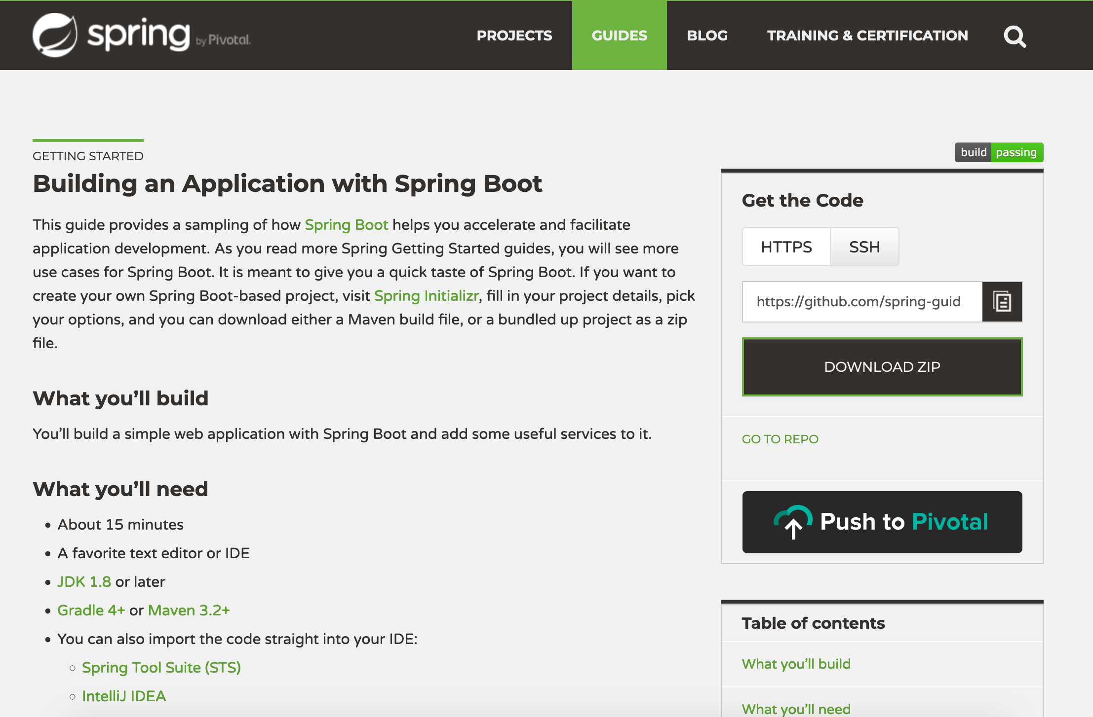
1 - Set up a basic project

Slide 8

2 - Add any dependencies
Notes:
This is google’s image for dependencies

Slide 9
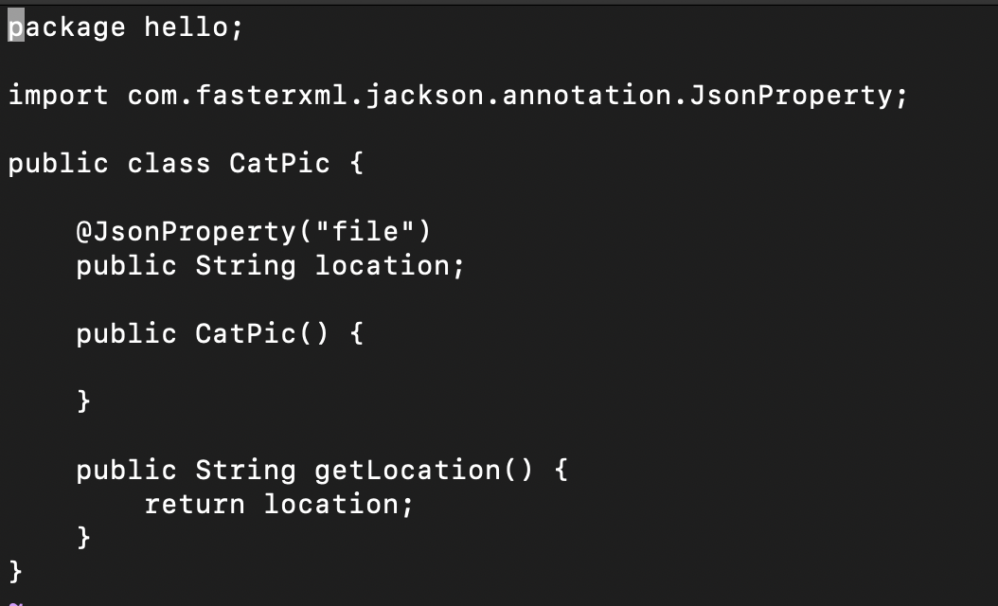
3 - Set up classes to manage responses

Slide 10

4 - Populate controller

Slide 11

Here’s one I made earlier
https://github.com/orbific/FunWithAPIs/

Slide 12
The Right Tool for the Job?
Is Java really the right thing to use here?

Slide 13
The Right Tool for the Job?
Is Java really the right thing to use here?
Angular would be a better option, perhaps?

Slide 14
The Right Tool for the Job?
Is Java really the right thing to use here?
Angular would be a better option, perhaps?
BUT - using a server allows certain options
We can track usage more easily
We can use more elegant solutions for caching, throttling error management and resilience

Slide 15
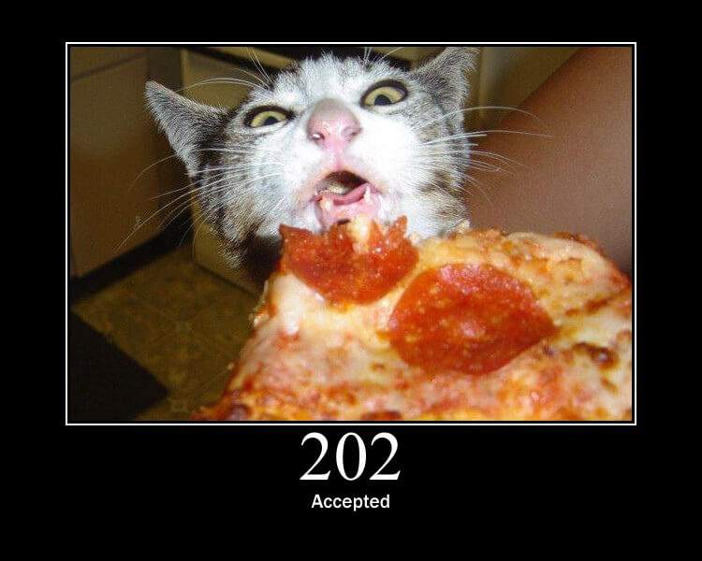
Let’s Go!

